Slide 1
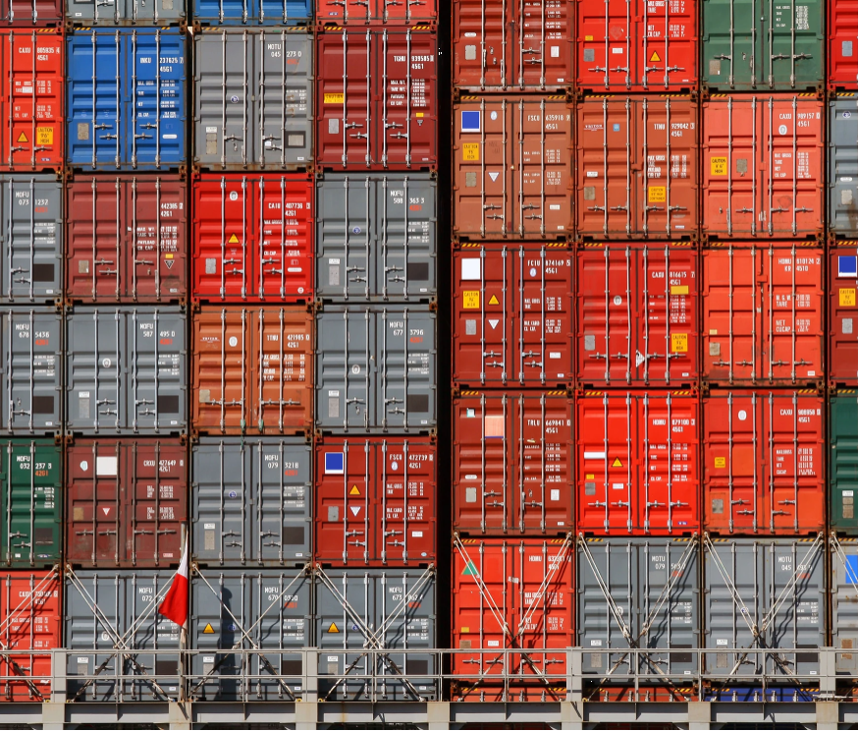



Market Entry
International trade business partner

Slide 2






AT GI America we help companies to expand their business to new horizons, with our vast knowledge and distribution capabilities in North America, we pave the road to leverage your market share and conquer it.
We select only the top brands and products to offer a great value proposition to our Canadian and USA customers; our rigorous assessment ensures quality and value to our final clients.
ZERO Emissions By 2026
At GI America, we are fighting the global battle to decarbonize logistics

Slide 3



CANADIAN PARTNERS
2018 GI America became a legal distributor of NUPEC products in CANADA
Distribution and logistics partner
Legal and import entity
Customer service, marketing and 3PL provider
Supply Chain without the burden of adding additional cost to the final customer.
Not another link to the consumer's chain
GI America as an extension of NUPEC in Canada.

Slide 4



Market Entry
2017
Business introduction, goals and objectives
Assessment
2018
Business strategy
Scope of Project
Project launch
Initiate protocols of international trade as both countries had never trade pet food CBSA – Mexico trade commissioner
2019
Trade compliance
CFIA permits
Label compliance English and French versions
2020
2021
2022
COVID-19 halted operations
Market analysis
Brand positioning, scientific advances, innovative packaging, business expansion
Validation of exportable offer value proposition
E-commerce project launch
2024
Launch super premium treats in CANADA
Nupec has positioned treats in major retail specialized stores selling across Canada
Pioneers of international trade
GI America is the first company ever to import Dog Pet Food from Mexico into Canada, as 90% of Canadian imports are coming from USA.

Slide 5


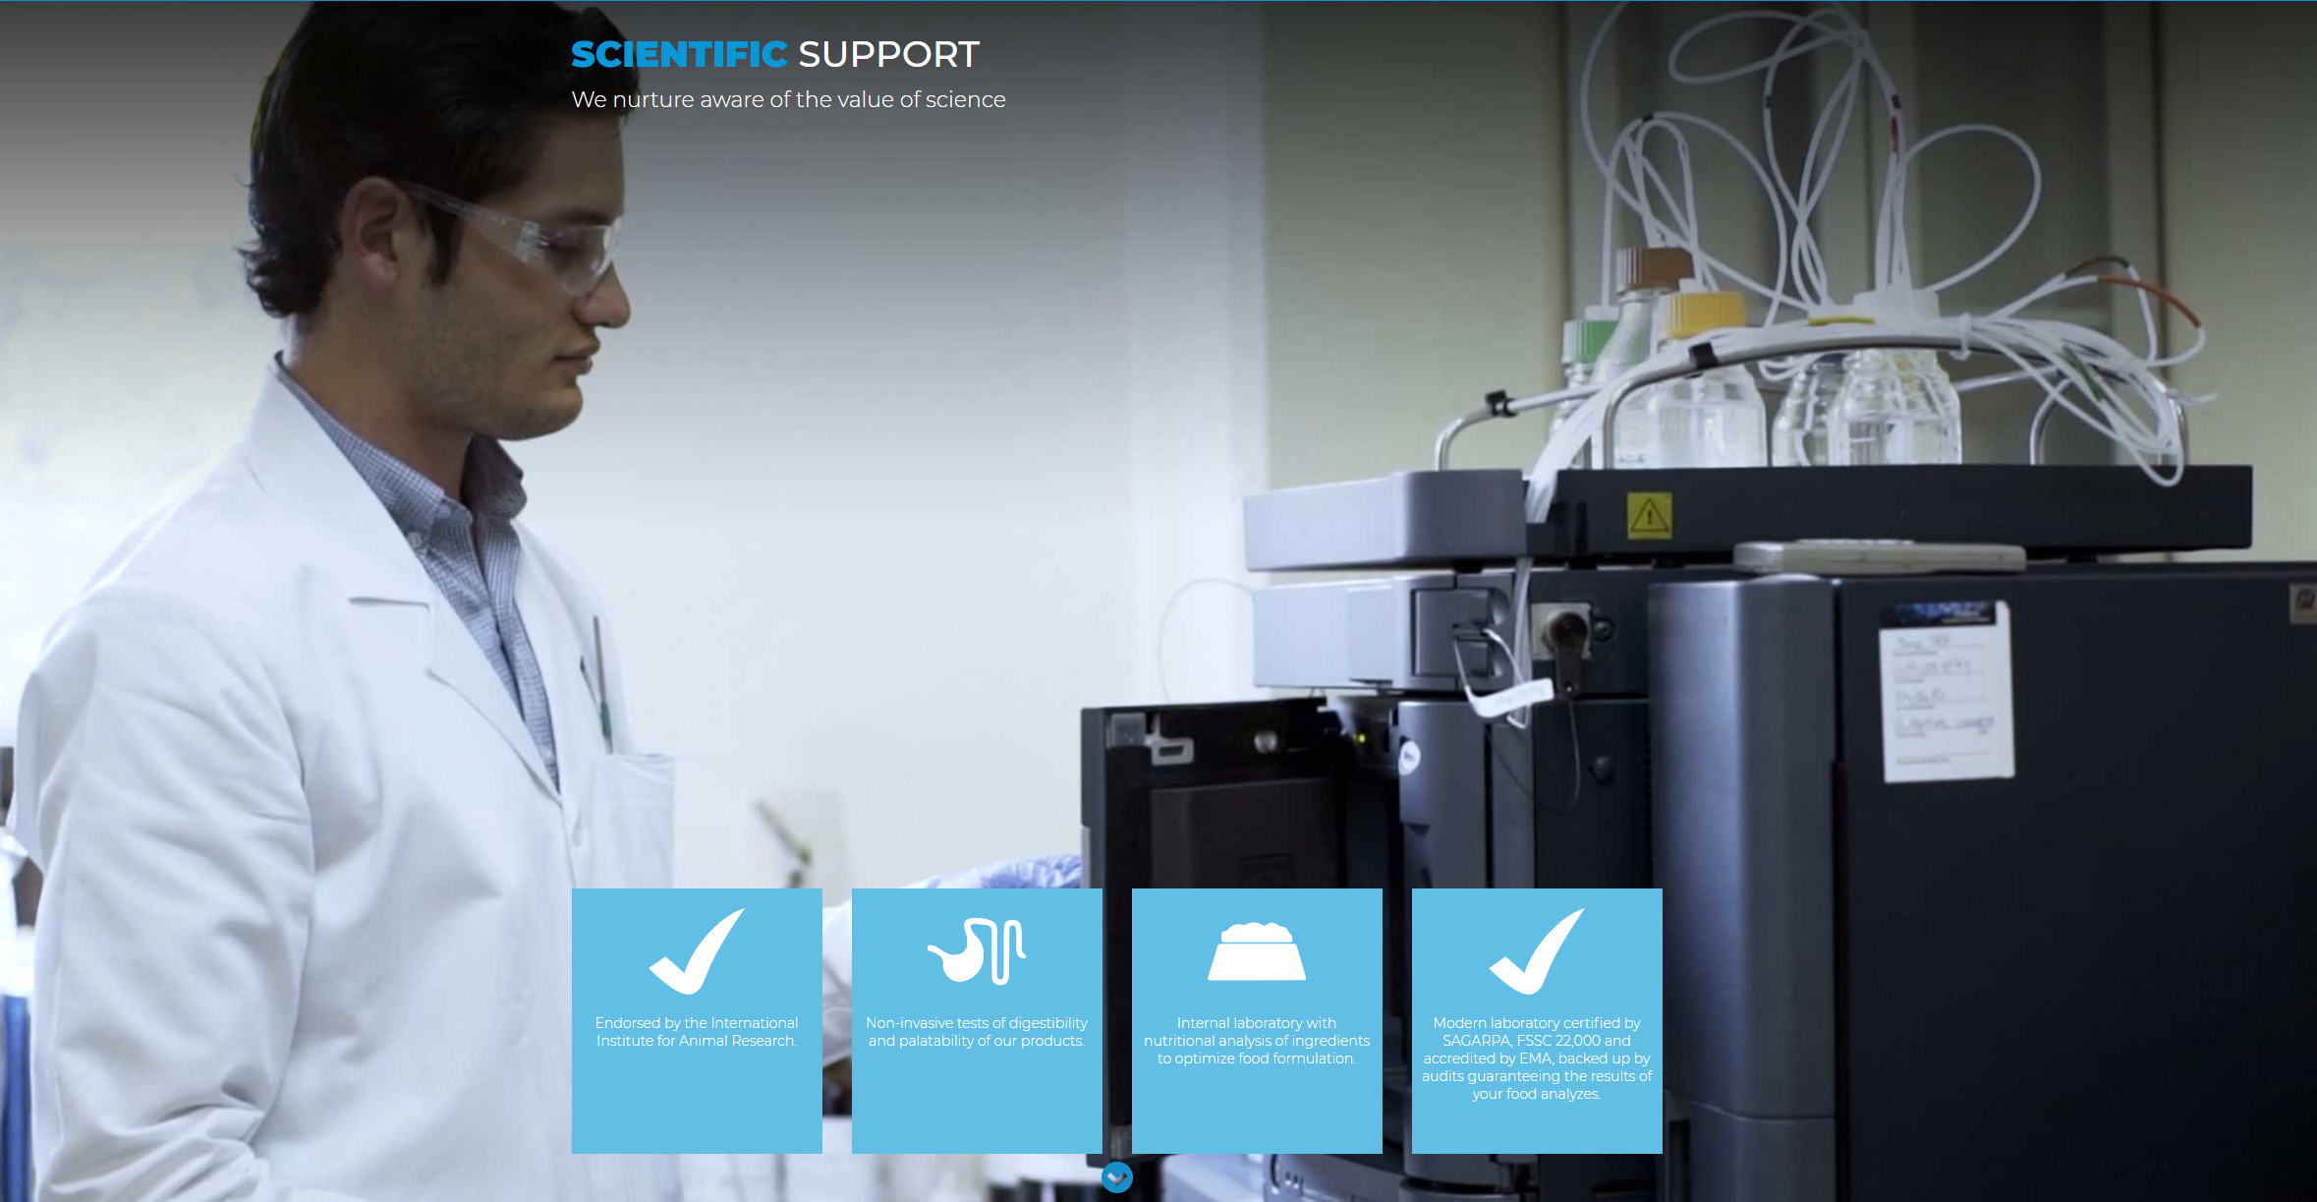
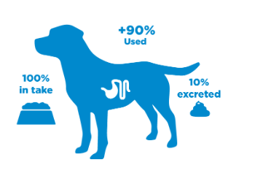
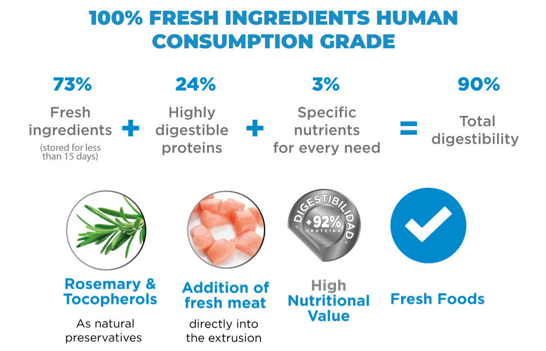
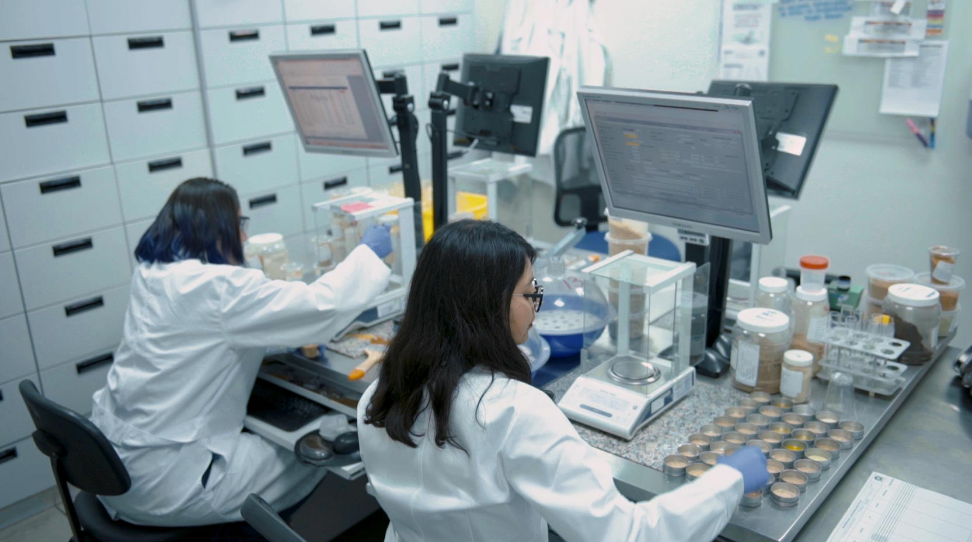
Value Proposition
Every dog ​​that collaborates in the institute was rescued and adopted. They are identified by their name, and they are cared for with great affection and respect.
In conjunction with veterinarians, food engineers and other nutrition experts, we developed our HIGH TECH formula that promotes 90% nutrient utilization..
SCIENTIFIC SUPPORT
We nurture aware of the value of science
DIGESTIBILITY
DIGESTIBILITY is a criterion that determines the usage level of food. Super Premium pet foods have a digestibility percentage greater than 90%.

Slide 6








BUSINESS UNITS
Feeds & Premix
Petfood
Aquafeed

Slide 7

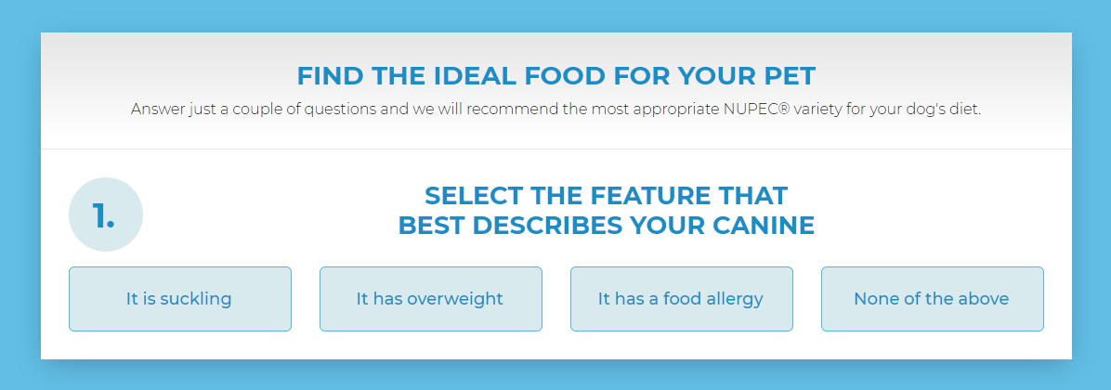
HIGH TECH FORMULA
For the last 10 years, the well-being and health of pets have been the focus of our research, development and innovation. Based on the most rigorous scientific framework and the application of high technology, we elaborate our balanced High-Tech formula that promotes a better response to the nutritional needs of each pet.
Together with a team of veterinarians, food engineers and other nutrition experts, at NUPEC® we elaborate our Hight Tech formula, which promotes 90% of nutrients utilization, through the incorporation of proteins as the first ingredient.

Slide 8
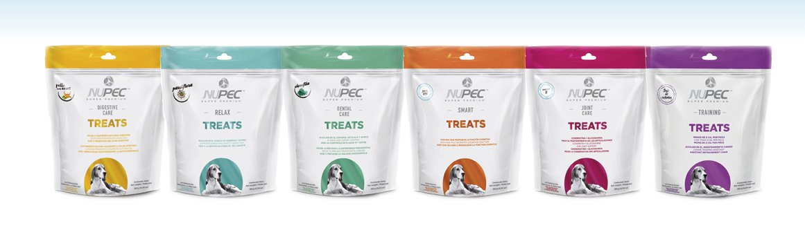
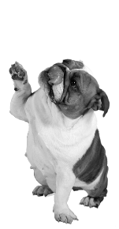

Treats
At NUPEC® we are aware of the need to pamper our pets. For this reason, we developed a line of treats with functional ingredients, which in addition to being rich and nutritious, provide a benefit in the life and health of our pets.

Slide 9



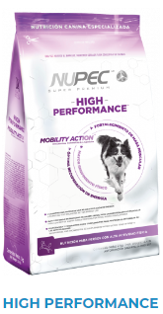
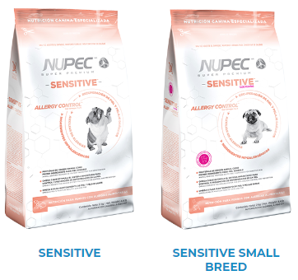
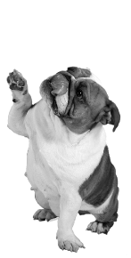




SPECIALIZED NUTRITION
Weight Control
High Performance
Sensitive breads
Aware of the specific needs of each canine, at NUPEC® we formulated a family of Specialized Super Premium products that are supported through nutritional scientific research, ensuring nutrition of the highest quality so that your pet and you continue to share unforgettable moments.

Slide 10
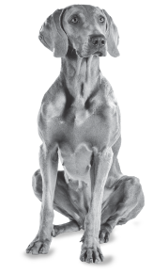
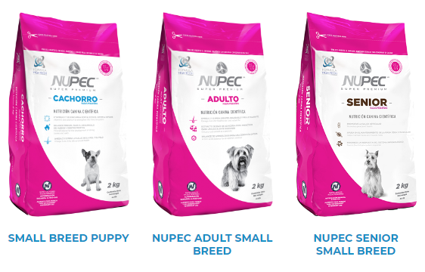
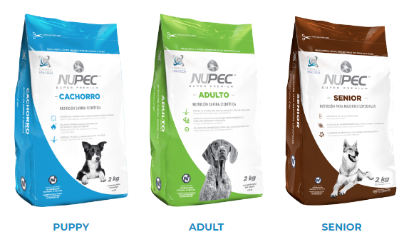
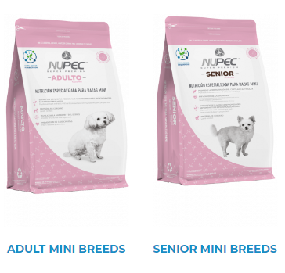
Scientific NUTRITION
PRODUCTS DESIGNED BY EXPERTS
Small Breads
Regular Breads
Mini Breads
At NUPEC we are aware of the particular needs of each dog, this is the reason why we design specific products for each stage of life or need diagnosed by the veterinary specialist, our passion is to promote health, beauty, life and animal productivity in order to nurture the fullness of HUMAN-CANINE relationships.

Slide 11


Our global service coverage
Montreal
Toronto
Vancouver
NY
Chicago
Los Angeles
Houston
MEXICO City
MEXICO - LATAM
CHINA
INDIA
THAILAND
VIETNAM
PHILIPPINES
SPAIN
GERMANY
UK

Slide 12

International trade business partner
150 Boulevard Montreal-Toronto
Lachine, Montreal QC
H8S 4L8 CANADA
Email: info@giamerica.ca
Call Free: 1 800-613-9979
Phone: (514) 400 2199
Fax: (514) 400 2180
www.giamerica.ca

